Slide 1
WEBPACK version 4
6th August, 2019

Slide 2
Agenda
1
Why & overview
2
Mode
3
Entry Points
4
Output
5
Loaders
6
Plugins
7
Configuration
8
Lazy loading

Slide 3
WHY

Slide 4
There are two ways to run JavaScript in a browser
Include a script for each functionality;
Hard to scale - Loading too many scripts (network)
Big .js file containing all your project code
Issues - Scope, size, readability and maintainability.

Slide 5
Why ?
TreeShaking – Removal of Redundant Code
Transpiling with babel
Minification
Asset Management
Customize
File Names to hashes

Slide 6
overview

Slide 7
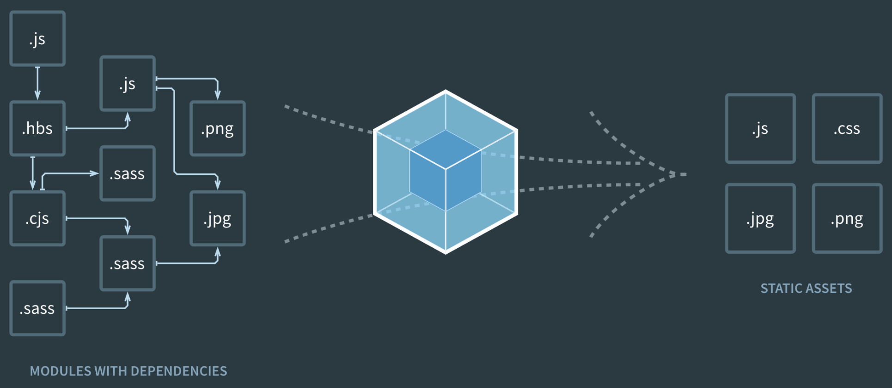
Overview
Webpack is a utility for bundling JavaScript applications. It takes in the source files of your application (which can be written in many different languages) and bundles them together into big packs of assets for the browser (JavaScript, HTML, CSS).

Slide 8
Overview
components/ Baz.js
bundle.js
index.js
components/Foo.js
components/ Faz.js
components/ Bar.js

Slide 9
Overview
WEBPACK FEATURES:
can work with some file formats out of the box,
dev-server,
watcher,
multiple bundles, common chunks,
build modes (dev, prod),
minor optimization

Slide 10
mode

Slide 11
Production mode
development mode
slower build
lesser size
more optimization
faster build
bigger size
less optimization

Slide 12
ENTRY POINTS

Slide 13
Entry Points

Slide 14
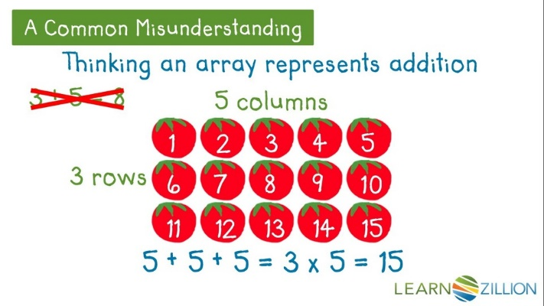
entry — Array

Slide 15
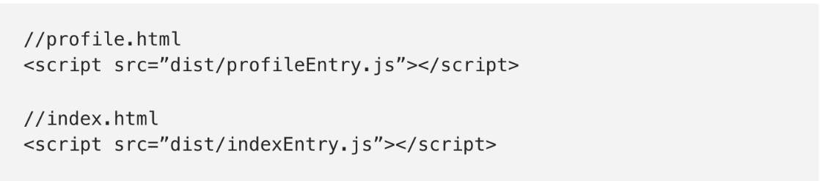
entry — object
Usage:

Slide 16

entry — combination

Slide 17
output

Slide 18
Output

Slide 19
CONFIGURATION

Slide 20
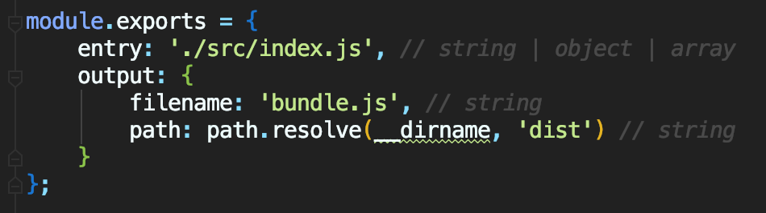
Configuration

Slide 21
loaders

Slide 22
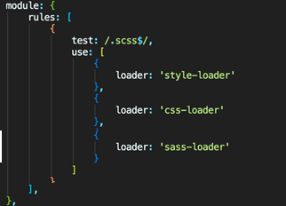
Loaders
A loader is just a function that takes in a string which contains a source file and returns a string which is then passed to the next loader in the chain.
Two Properties :- 1) test 2) use
sass-loader is a loader for Webpack for compiling SCSS/Sass files.
css-loader interprets @import and @url() and resolves them.
style-loader injects our styles into our DOM.
mini-css-extract-plugin extracts our CSS out of the JavaScript
bundle into a separate file, essential for production builds.

Slide 23
style-loader injects our styles into our DOM.
css-loader interprets @import and @url() and resolves them.
mini-css-extract-plugin extracts our CSS out of the JavaScript bundle into a separate file, essential for production builds.

Slide 24
plugins

Slide 25
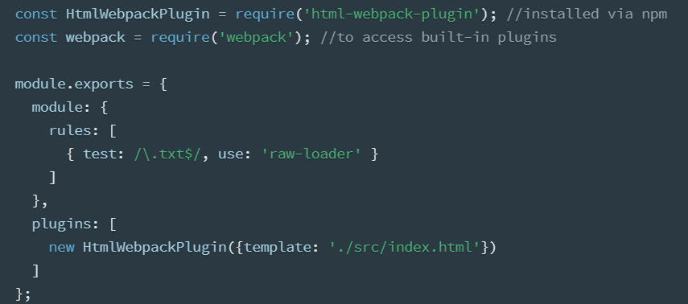
Plugins
Bundle optimization
Asset management and injection of environment variables.

Slide 26
DEV SERVER

Slide 27
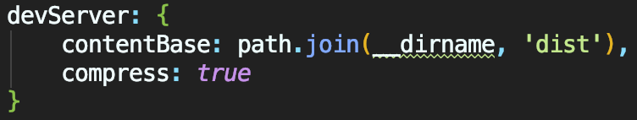
Dev Server
useful for development (hence the name)
easy to use
live reload
can be used with minimal configuration
npm i -D webpack-dev-server

Slide 28
lazy loading

Slide 29
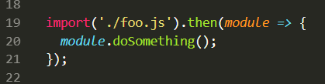
Lazy loading
Usually imports are always restricted to the top of the module, but with ES6 deferred imports you can import files conditionally (only when they are needed), and Webpack supports that.

Slide 30
Questions

Slide 31
Questions

